Slide 1
WNSpell: A WordNet-Based Spell Corrector
Bill Huang
Princeton University
Global WordNet Conference 2016 Bucharest, Romania

Slide 2
Goals
  Create a spell corrector for WordNet queries (online interface)
  Improve upon spelling correction
    Specifically context-free spelling correction
    Taking advantage of WordNet semantics
Global WordNet Conference 2016 Bucharest, Romania

Slide 3
Goal
Should be robust, dynamic, and quick
  Handle a variety of errors
  Accurate correction
  Acceptable execution time
Including…
Typos: Aurocorrect -> Autocorrect
Spelling Errors: Funetiks -> Phonetics
Fundamental Errors: Misilous -> Miscellaneous
Global WordNet Conference 2016 Bucharest, Romania

Slide 4
This Project
Two Parts:
Basic spelling correction improvement
Semantic-based improvement
Global WordNet Conference 2016 Bucharest, Romania

Slide 5
Part I: Basic Improvement
Target: simple context-free spell correction
User enters (misspelled) query
Returns ordered list of suggestions
Global WordNet Conference 2016 Bucharest, Romania

Slide 6
Approach
  Generate a search space of possible corrections
  Prune the search space
  Score each candidate correction
  Return ordered list of top few candidates
Candidate | Score
Close | 1733
Closer | 1373
Closest | 1337
Not so close | 3731
Kind of close | 3137
Output
Closest
Closer
Close
Pruned Candidates
Initial Search Space
Dictionary
Global WordNet Conference 2016 Bucharest, Romania

Slide 7
Generating the Search Space
  Containment: includes desired correction
  Performance: time taken
Initial Search Space
Dictionary
Global WordNet Conference 2016 Bucharest, Romania

Slide 8
Generating the Search Space
Past Approaches:
  Exhaustive edit distance search
              only minor errors caught
  Phonetic matching
          typos missed
  Similarity key
              reliant on perfect key
  Rule-based search
        unconventional errors missed
→We use a combination
Global WordNet Conference 2016 Bucharest, Romania

Slide 9
Generating the Search Space
Past Approaches:
  Exhaustive edit distance search
              only minor errors caught
  Phonetic matching
          typos missed
  Similarity key
              reliant on perfect key
  Rule-based search
        fails on unconventional errors
→We use a combination
Global WordNet Conference 2016 Bucharest, Romania

Slide 10
Generating the Search Space
  Words within a certain edit distance
  Words with the same phonetic key
  Words with a phonetic key within a certain edit distance
  A few rule-based exceptions
Global WordNet Conference 2016 Bucharest, Romania

Slide 11
Generating the Search Space
Phonetic Key:
  Consonant sounds only
    First 5 sounds
    [00000] – [99999]
  Pre-calculated
  (ignored) a, e, i, o, u, h, w, [gh](t)
  b, p
  k, c, g, j, q, x
  s, z, c(i/e/y), [ps], t(i o), (x)
  d, t
  m, n, [pn], [kn]
  l
  r
  f, v, (r/n/t o u)[gh], [ph]
Modified Soundex
Global WordNet Conference 2016 Bucharest, Romania

Slide 12
Generating the Search Space
  Words within a certain edit distance
  Words with the same phonetic key
  Words with a phonetic key within a certain edit distance
  A few rule-based exceptions
Global WordNet Conference 2016 Bucharest, Romania

Slide 13
Pruning the Search Space
  Containment: includes desired correction
  Size: number of candidates left
  Performance: time taken
Pruned Candidates
Initial Search Space
Global WordNet Conference 2016 Bucharest, Romania

Slide 14
Pruning the Search Space
Combination of:
  How the candidate was generated
    i.e. simple typo, far-fetched phonetic similarity, etc.
  Morphological factors:
Length
Letters contained
Phonetic Key
First/last letters
Number of syllables
Frequency in corpus
Edit distance
Pruned Candidates
Initial Search Space
Global WordNet Conference 2016 Bucharest, Romania

Slide 15
Scoring Candidates
  Accuracy: measures similarity reliably
  Performance: time taken
Candidate | Score
Close | 1733
Closer | 1373
Closest | 1337
Not so close | 3731
Kind of close | 3137
Global WordNet Conference 2016 Bucharest, Romania

Slide 16
Scoring Candidates
Based on noisy channel scoring
Adds empirical modifications
Global WordNet Conference 2016 Bucharest, Romania

Slide 17
Scoring Candidates
Noisy Channel Scoring
  Obtain bigram/monogram counts
  Obtain error counts:
    Deletion of y after x
    Addition of y after x
    Substitution of y for x
    Adjacent transposition of xy
  Smooth counts
Global WordNet Conference 2016 Bucharest, Romania

Slide 18
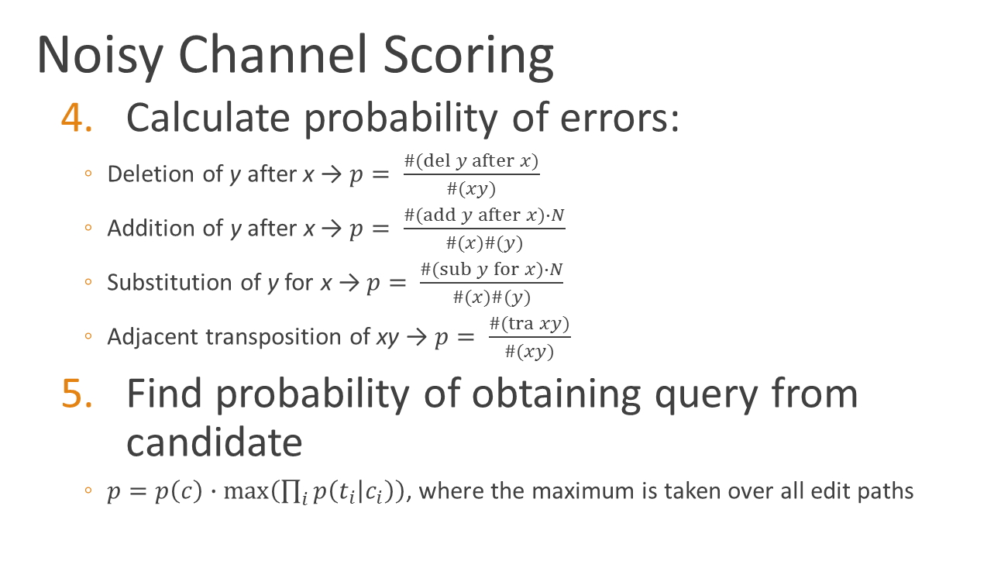
Scoring Candidates
Noisy Channel Scoring
  Calculate probability of errors:
    Deletion of y after x → $p= \frac{\#(del y after x)}{\#(xy)}$
    Addition of y after x → $p= \frac{\#(add y after x)∙N}{\#(x)\#(y)}$
    Substitution of y for x → $p= \frac{\#(sub y for x)∙N}{\#(x)\#(y)}$
    Adjacent transposition of xy → $p= \frac{\#(tra xy)}{\#(xy)}$
  Find probability of obtaining query from candidate
    $p=p\left(c\right)∙max\left(\prod_{i}{p\left(t_{i} | c_{i}\right)}\right)$, where the maximum is taken over all edit paths
Global WordNet Conference 2016 Bucharest, Romania

Slide 19
Scoring Candidates
Based on noisy channel scoring
Adds empirical modifications
Global WordNet Conference 2016 Bucharest, Romania

Slide 20
Scoring Candidates
Empirical modifications
  Adjustment to noisy channel model:
  Additional factors included:
Increased likelihood of errors when many are present
Adjusted influence of frequency of candidate in corpus
Same (consonant) phonetics
Same (ordered) consonants
Same (ordered) vowels
Same number of syllables
Same set of letters
Similar set of letters
Same aside from repetition
Same aside from e’s
Global WordNet Conference 2016 Bucharest, Romania

Slide 21
Returning Suggestions
Call a library sort
Candidate | Score
Close | 1733
Closer | 1373
Closest | 1337
Not so close | 3731
Kind of close | 3137
Output
Closest
Closer
Close
Global WordNet Conference 2016 Bucharest, Romania

Slide 22
Results
  Using Aspell data set
    Tough misspellings as training/test set
    Common misspellings as blind test set
  Outperforms other spell correctors
Global WordNet Conference 2016 Bucharest, Romania

Slide 23
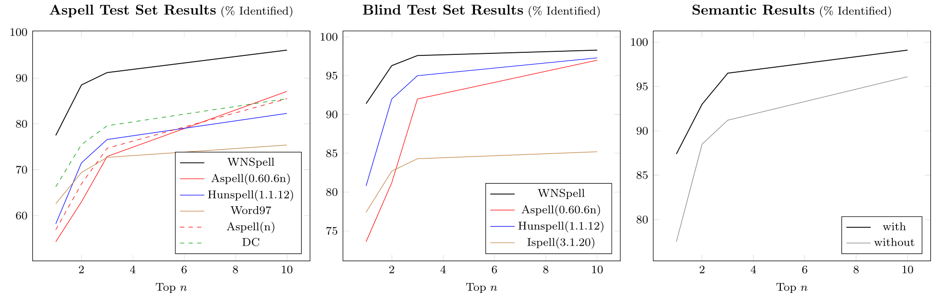
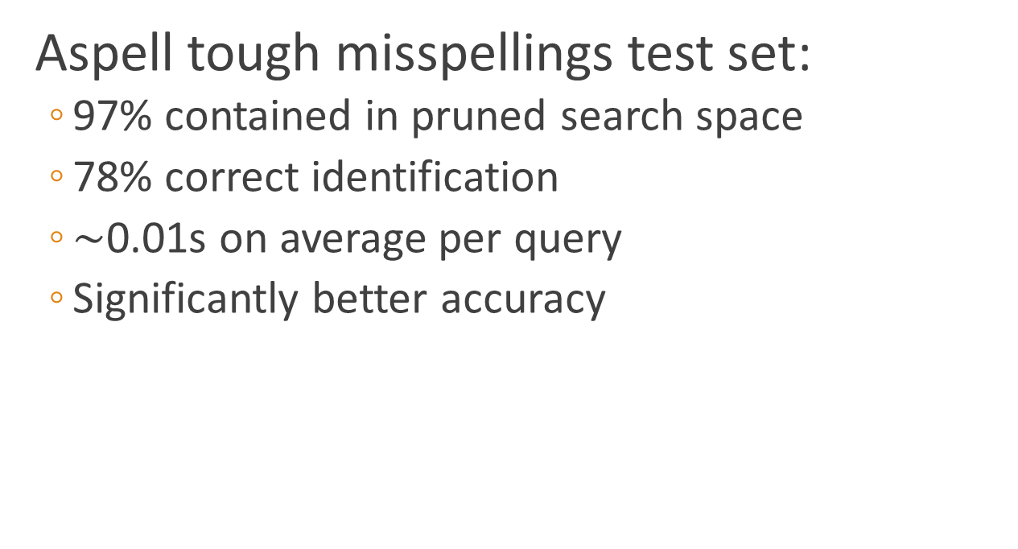
Results
Aspell tough misspellings test set:
  97% contained in pruned search space
  78% correct identification
  $\sim$0.01s on average per query
  Significantly better accuracy
Global WordNet Conference 2016 Bucharest, Romania

Slide 24
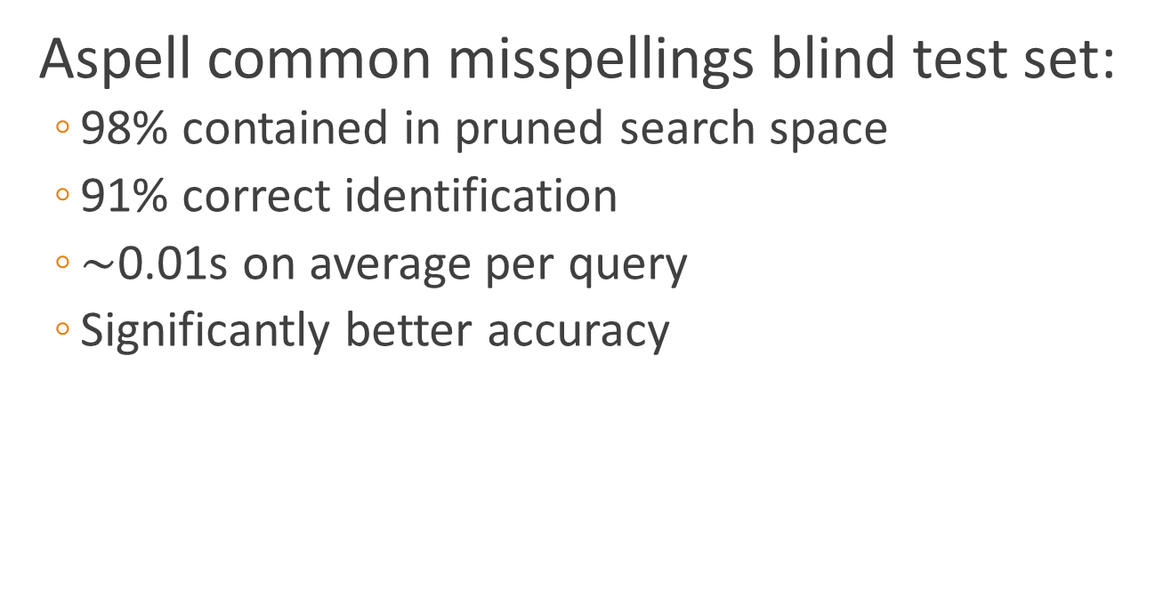
Results
Aspell common misspellings blind test set:
  98% contained in pruned search space
  91% correct identification
  $\sim$0.01s on average per query
  Significantly better accuracy
Global WordNet Conference 2016 Bucharest, Romania

Slide 25
Part II: Semantic Improvement
Goal:
Take advantage of WordNet’s semantic information to improve spelling correction

Slide 26
Part II: Semantic Improvement
Target: context-free spell correction
User enters (misspelled) query
User enters in related word
Returns ordered list of suggestions
Global WordNet Conference 2016 Bucharest, Romania

Slide 27
Adding in Semantics
  Enhanced search space generation
  Refined scoring system
Global WordNet Conference 2016 Bucharest, Romania

Slide 28
Enhanced Search Space
More thorough initial search space:
  For each synset of the related word
    For each synset semantically related to one of them
      For each lemma of these synsets
        If it is similar enough to the query
Synset
Lemmas
Synset
Synset
Similar Lemmas
Related Word
Synset
Synset
Synset
Synset
Synset

Slide 29
Enhanced Search Space
Lemma similarity:
  Semantic distance
    i.e. same synset v. related synset
  Edit distance
  Morphological features:
    First/last letters
Global WordNet Conference 2016 Bucharest, Romania

Slide 30
Adding in Semantics
  Enhanced search space generation
  Refined scoring system
Global WordNet Conference 2016 Bucharest, Romania

Slide 31
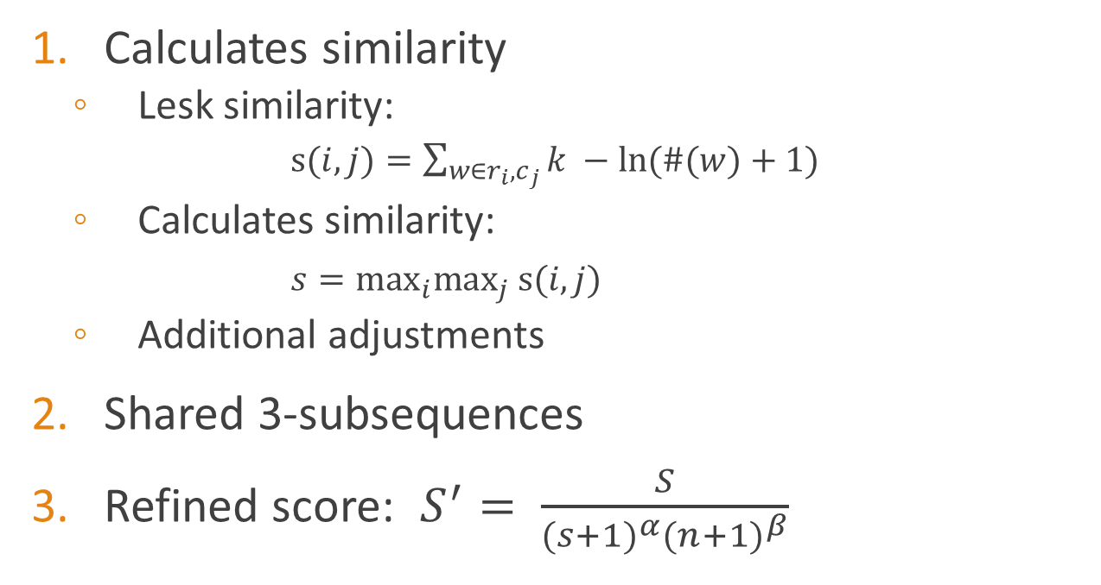
Refined Scoring
Calculates similarity
  Lesk similarity:
    . $s(i,j)=\sum_{w∈r_{i},c_{j}}{k −ln(\#(w)+1)}$
  Calculates similarity:
  . $s=\max_{i}\max_{j} s(i,j)$
  Additional adjustments
Shared 3-subsequences
Refined score: $S^{′}= \frac{S}{{(s+1)}^{α}{(n+1)}^{β}}$
Global WordNet Conference 2016 Bucharest, Romania

Slide 32
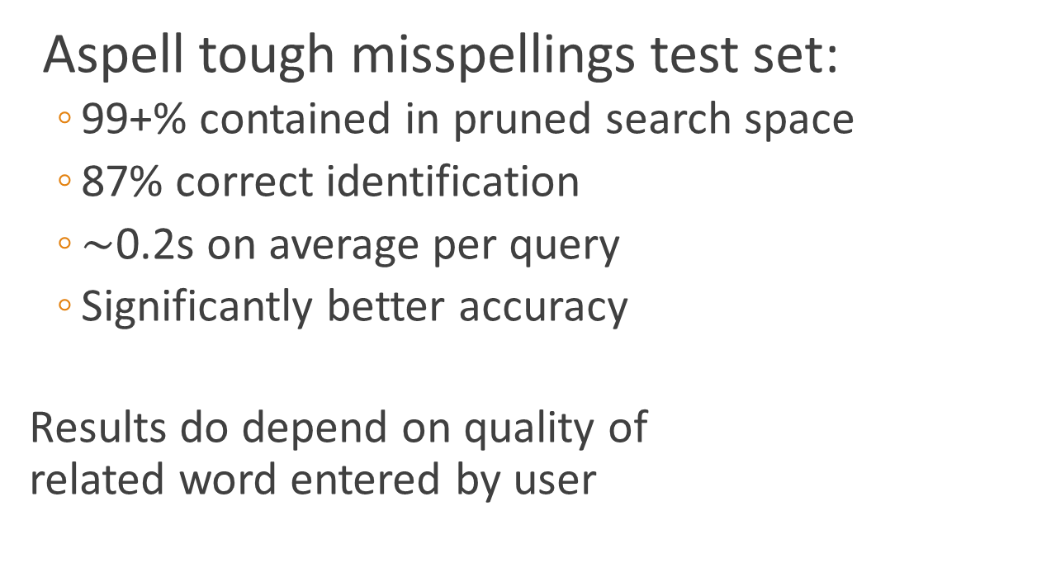
Results
Aspell tough misspellings test set:
  99+% contained in pruned search space
  87% correct identification
  $\sim$0.2s on average per query
  Significantly better accuracy
Results do depend on quality of
related word entered by user
Global WordNet Conference 2016 Bucharest, Romania

Slide 33
Conclusions
  Both improved spell correctors perform well
    Outperforms current context-free spell correctors
    Semantic addition does depend on related word
    Some simple exceptions still missed
      i.e. spoak -> spoke instead of -> speak
  Next step: contextual correction
Global WordNet Conference 2016 Bucharest, Romania

Slide 34
Contextual Spell Correction
How to apply semantics?
  May not outperform current statistical methods
    Especially time-wise
  Instead, use as supplement
Global WordNet Conference 2016 Bucharest, Romania

Slide 35
Thank You
Global WordNet Conference 2016 Bucharest, Romania

